Slide 1







SQL PROJECT
Consumer Goods Ad-Hoc Insights
Designed by
Jagadeesh Singidi

Slide 2

OVERVIEW
INTRODUCTION
PROBLEM STATEMENT
RELATIONSHIP VIEW
AD-HOC-INSIGHTS AND ITS RESULTS
TOP SALES BASED ON CATEGORIES

Slide 3

AtliQ Business Model
AtliQ Hardwares (imaginary company) is one of the leading Computer hardware producers in India and well expanded in other countries too.
AtliQ’s Fiscal Year
(September 2019 – August 2019 ) – FY 2020
(September 2020 – August 2020) – FY 2021

Slide 4
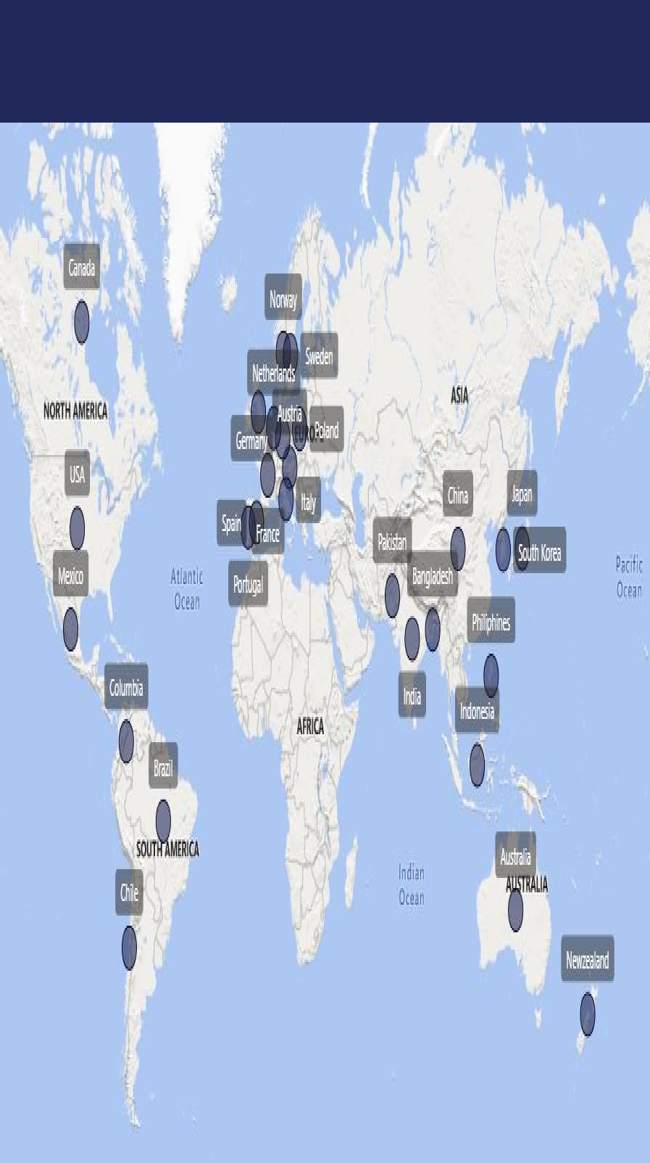
AtliQ’s Market

Slide 5
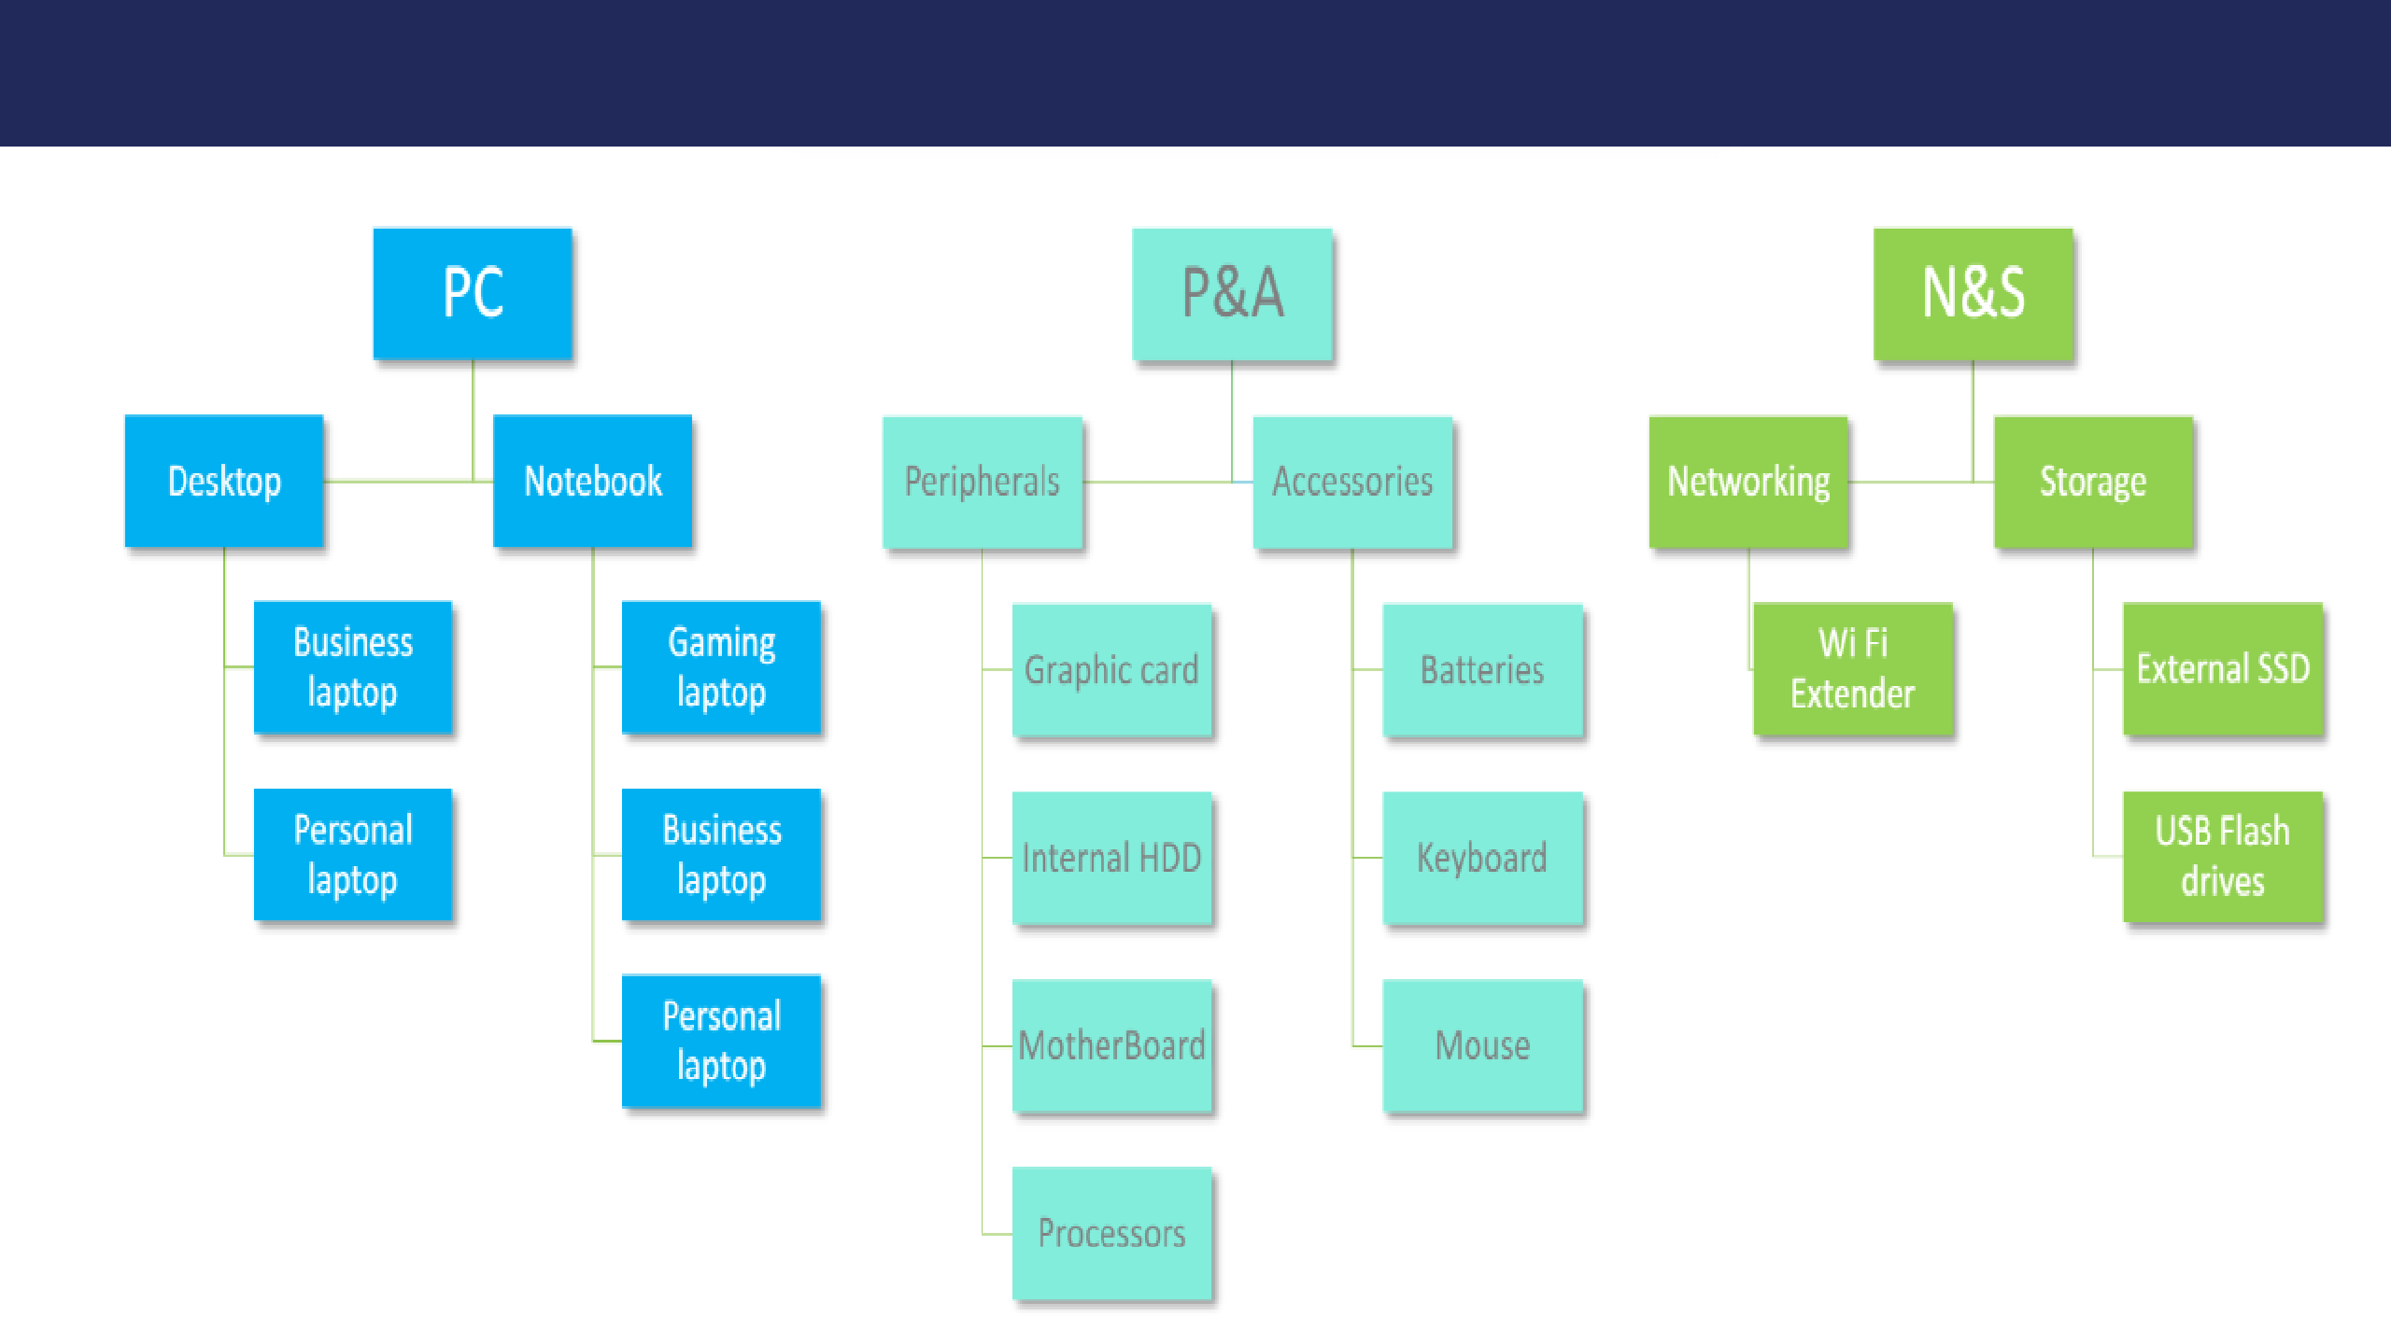
Division - Segment - Category

Slide 6

PROBLEM STATEMENT
Management noticed that they have insufficient insights to make quick and smart data- informed decisions. They want to expand their data analytics team by adding several junior data analysts.

Slide 7

APPROACH
They provide 10 Ad-hoc-Requests and asked us to solve using SQL Query ,convert SQL output into visualization and present Insights to Top-Level-Management.

Slide 8
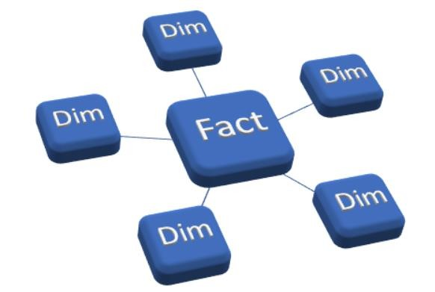
STAR SCHEMA
A star schema is a type of data modeling technique used in data warehousing to organize data in a structured and intuitive way.
As shown in the image above, data is organized into a central fact table that contains the measures of interest, surrounded by dimension tables that describe the attributes of the measures.

Slide 9
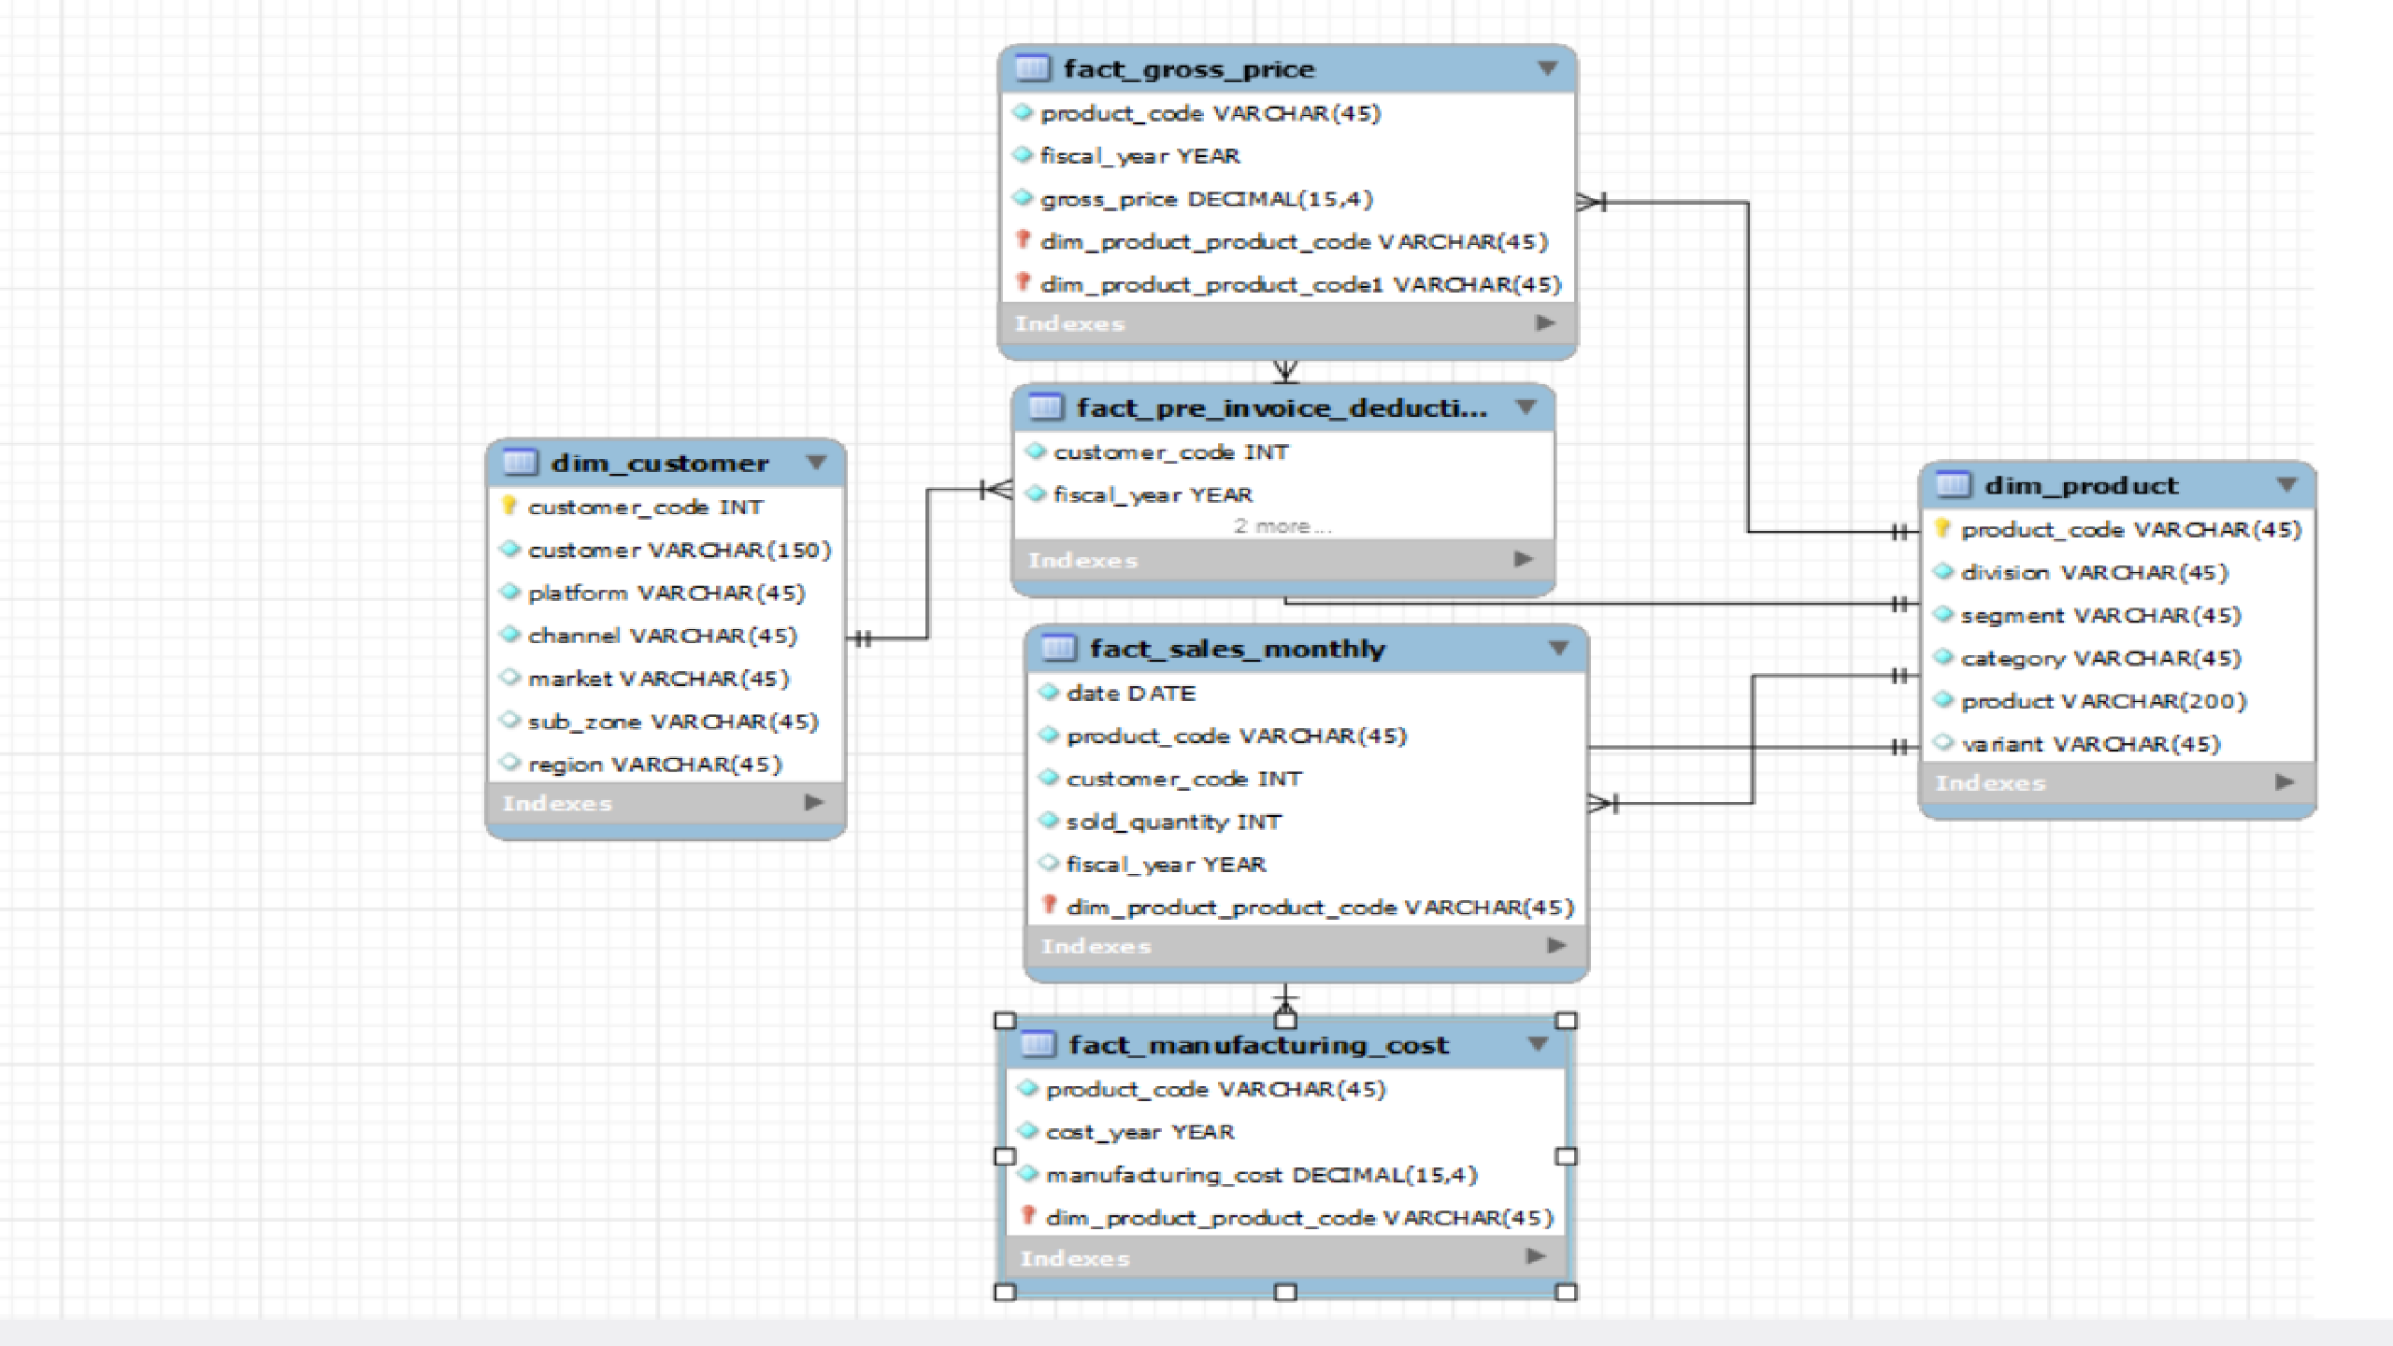

Slide 10
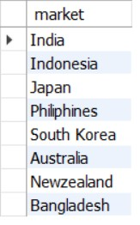


#TASK 1
Provide the list of markets in which customer "Atliq Exclusive" operates its business in the APAC region.

Slide 11

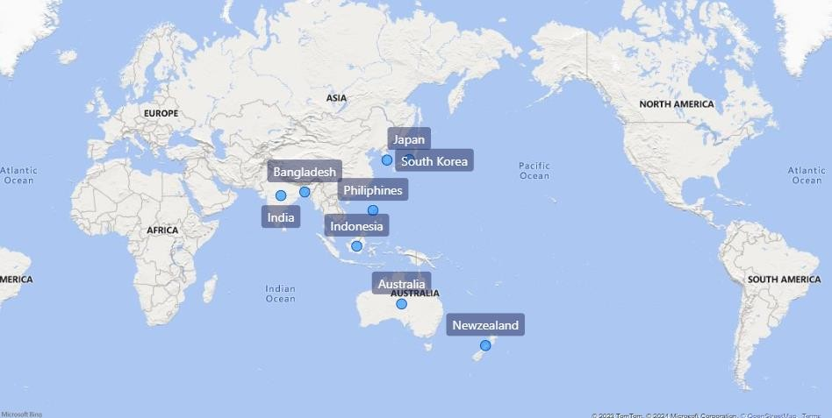
AtliQ Exclusive store operates its Business in 8 major markets in the APAC region

Slide 12

#TASK 2
What is the percentage of unique product increase in 2021 vs. 2020? The final output contains these fields, unique_products_2020 unique_products_2021 percentage_chg?

Slide 13
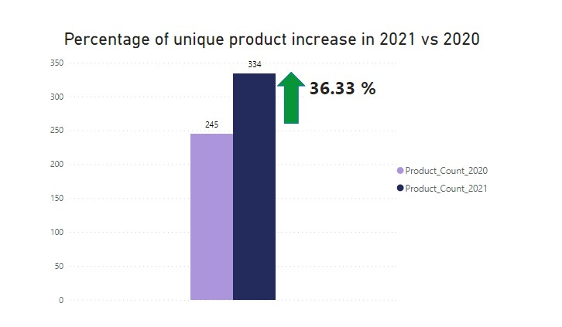
FY 2020 - 245 Products
FY 2021 – 334 Products
Product count increase – 36.33% compared to FY 2020

Slide 14
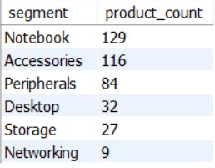
#TASK 3
Provide a report with all the unique product counts for each segment and sort them in descending order of product counts. The final output contains 2 fields, segment product_count 4.

Slide 15
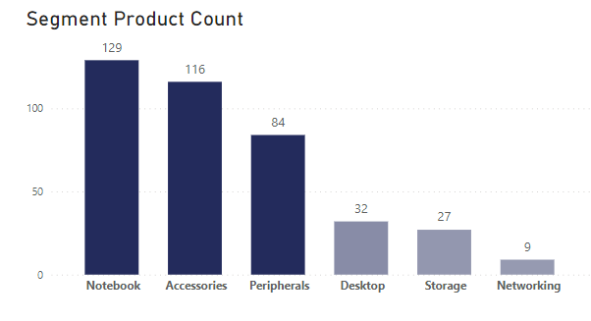
The number of products we sell under the segment Notebook, Accessories & Peripherals are higher.
We need to increase our sales and production in the Desktop, Networking & Storage segments by providing some discounts.

Slide 16
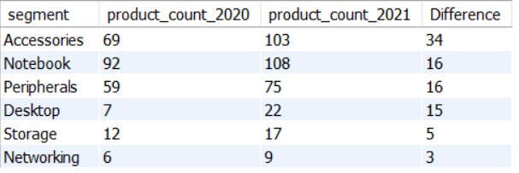
#TASK 4
Which segment had the most increase in unique products in 2021 vs 2020? The final output contains these fields, segment product_count_2020 product_count_2021 difference.

Slide 17
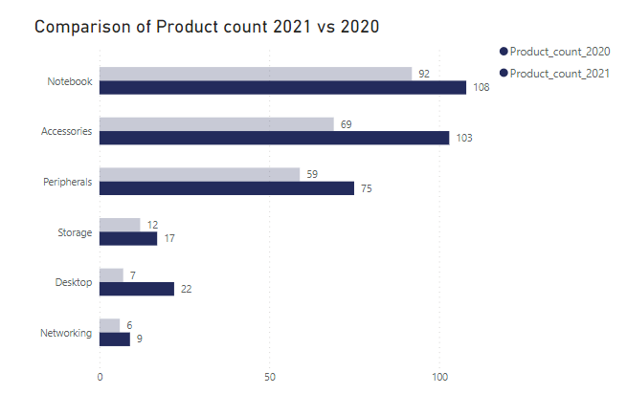
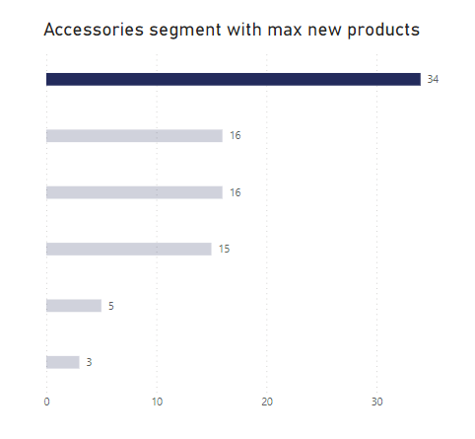
The Accessories segment had the most unique product increase in 2021 compared
to 2020, with 234 new products.

Slide 18

#TASK 5
Get the products that have the highest and lowest manufacturing costs. The
final output should contain these fields, product_code product manufacturing_cost.

Slide 19
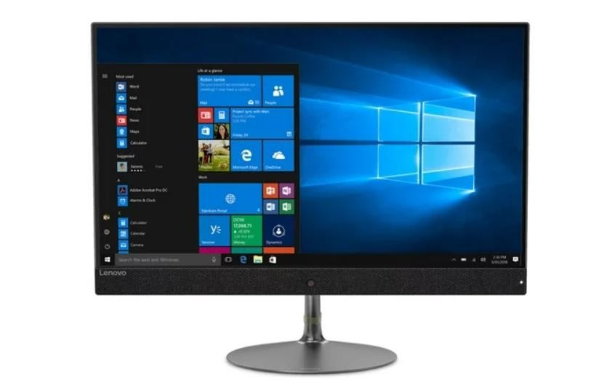

$ 0.89
$ 240.53
Highest Manufacturing Cost
Lowest Manufacturing Cost
AQ HOME Allin1 Gen 2 ( Personal Desktop )
AQ Master wired x1 Ms
( Mouse )

Slide 20
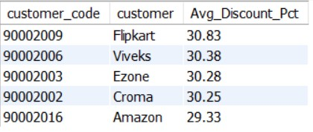
#TASK 6
Generate a report which contains the top 5 customers who received an average high pre_invoice_discount_pct for the fiscal year 2021 and in the Indian market. The final output contains these fields, customer_code ,customer average_discount_pct.

Slide 21
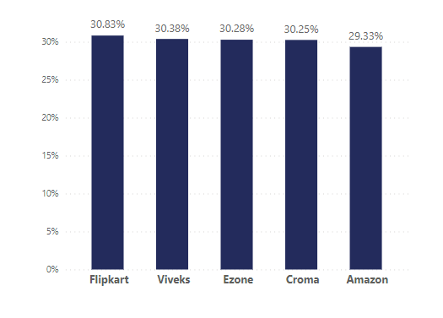
In FY 2021, the top 5 customers were offered nearly equal pre-invoice discount percentages. Among them, Flipkart received the highest discount at 30.83%.

Slide 22
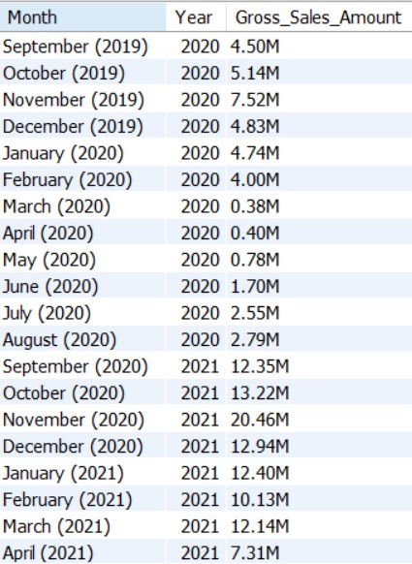
#TASK 7
Get the complete report of the Gross sales amount for the customer “Atliq Exclusive” for each month.This analysis helps to get an idea of low and high- performing months and take strategic decisions. The final report contains these columns: Month Year Gross sales Amount

Slide 23
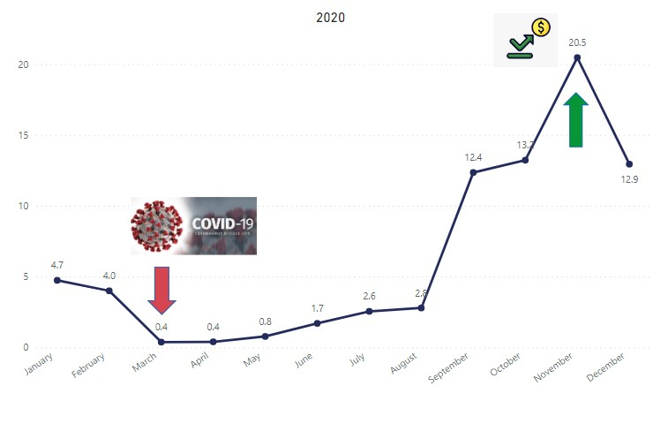
Highest Sales : November 2020
Lowest Sales : March 2020
Due to COVID, sales were at their lowest in March, and they bounced back in November with sales reaching 20.46 million, the highest ever compared to the previous year's data

Slide 24
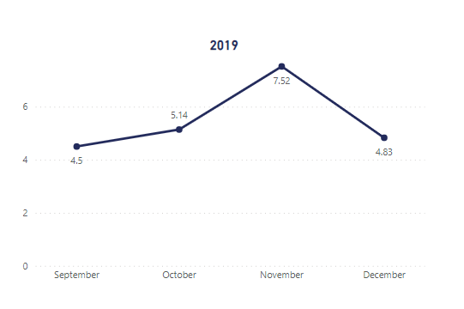
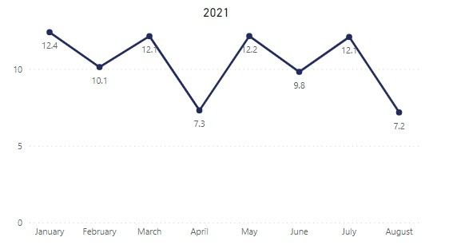

Slide 25
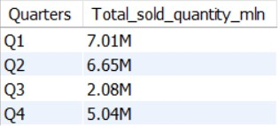
#TASK 8
In which quarter of 2020, got the maximum total_sold_quantity? The final output
contains these fields sorted by the total_sold_quantity, Quarter total_sold_quantity.

Slide 26
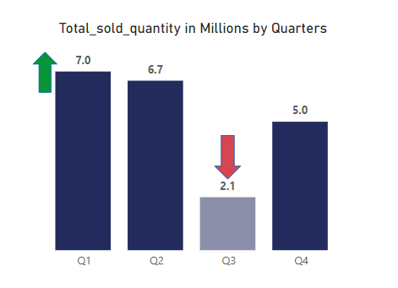
Highest Sold Quantity in 2020 – Quarter 1
Lowest Sold Quantity in 2020 – Quarter 3
Quarter 3 – March, April , May for AtliQ Hardwares
Covid was at its peak during that time

Slide 27
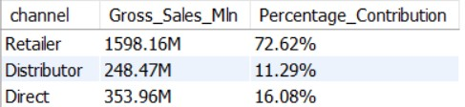
#TASK 9
Which channel helped to bring more gross sales in the fiscal year 2021 and the percentage of contribution? The final output contains these fields, channel gross_sales_mln percentage.

Slide 28
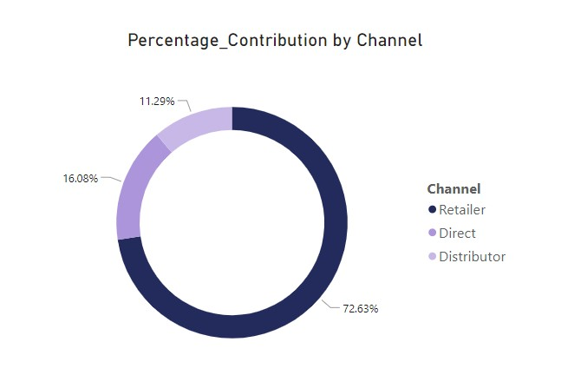
Retailer is the highest contributor in Gross_Sales with 72.62%
Distributor and Direct is the remaining 25% contribution

Slide 29
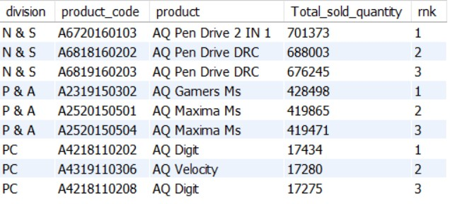
#TASK 10
Get the Top 3 products in each division that have a high total_sold_quantity in the fiscal_year 2021? The final output contains these fields - division, product_code, product, total_sold_quantity, rank_order.

Slide 30


amazon.com

Slide 31

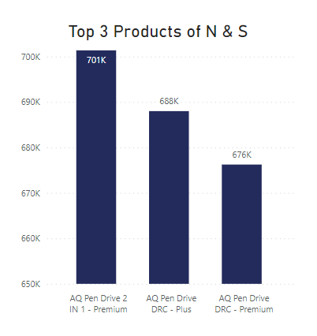
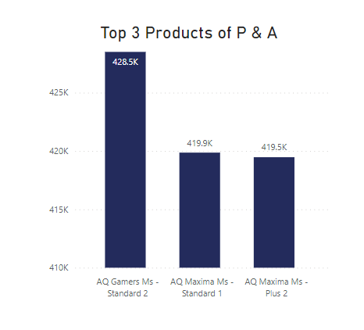
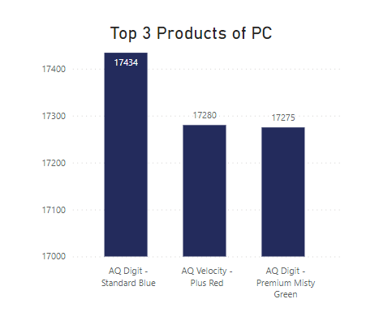

Slide 32

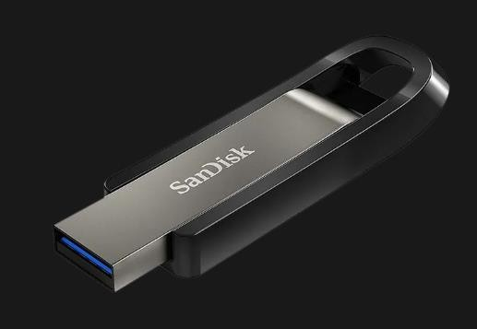



Slide 33


